Slide 1
CS 570: Data Structures
Heaps and Priority Queues
Notes:
talk about the rest of the semester.

Slide 2
Heaps and Priority Queues

Slide 3
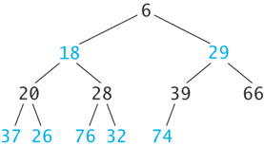
Heaps and Priority Queues
A (min) heap is a complete binary tree with the following properties
The value in the root is the smallest item in the tree
Every subtree is a heap

Slide 4

Inserting an Item into a Heap
6
18
29
20
28
39
66
37
26
76
32
74
89

Slide 5
Inserting an Item into a Heap (cont.)
6
18
29
20
28
39
66
37
26
76
32
74
89
8

Slide 6
Inserting an Item into a Heap (cont.)
6
18
29
20
28
39
8
37
26
76
32
74
89
66

Slide 7
Inserting an Item into a Heap (cont.)
6
18
8
20
28
39
29
37
26
76
32
74
89
66

Slide 8
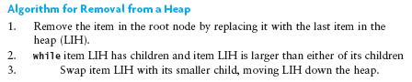
Removing an Item from a Heap
6
18
8
20
28
39
29
37
26
76
32
74
89
66

Slide 9
Removing an Item from a Heap (cont.)
6
18
8
20
28
39
29
37
26
76
32
74
89
66

Slide 10
Removing an Item from a Heap (cont.)
66
18
8
20
28
39
29
37
26
76
32
74
89

Slide 11
Removing an Item from a Heap (cont.)
8
18
66
20
28
39
29
37
26
76
32
74
89

Slide 12
Removing an Item from a Heap (cont.)
8
18
29
20
28
39
66
37
26
76
32
74
89

Slide 13
Implementing a Heap
Because a heap is a complete binary tree, it can be implemented efficiently using an array rather than a linked data structure

Slide 14
Implementing a Heap (cont.)
8
8
29
18
29
18
39
66
20
66
20
28
28
39
37
37
26
26
76
76
32
32
74
74
89
89
0
1
2
3
4
5
6
7
8
9
10
11
12
8
18
29
20
28
39
66
37
26
76
32
74
89

Slide 15
Implementing a Heap (cont.)
For a node at position p, L. child position: 2p + 1
R. child position: 2p + 2
8
18
29
20
28
39
66
37
26
76
32
74
89
0
1
2
3
4
5
6
7
8
9
10
11
12
8
18
29
20
28
39
66
37
26
76
32
74
89
Parent
L. Child
R. Child

Slide 16
Implementing a Heap (cont.)
For a node at position p, L. child position: 2p + 1
R. child position: 2p + 2
8
18
29
20
28
39
66
37
26
76
32
74
89
0
1
2
3
4
5
6
7
8
9
10
11
12
8
18
29
20
28
39
66
37
26
76
32
74
89
Parent
L. Child
R. Child

Slide 17
Implementing a Heap (cont.)
For a node at position p, L. child position: 2p + 1
R. child position: 2p + 2
8
18
29
20
28
39
66
37
26
76
32
74
89
0
1
2
3
4
5
6
7
8
9
10
11
12
8
18
29
20
28
39
66
37
26
76
32
74
89
Parent
L. Child
R. Child

Slide 18
Implementing a Heap (cont.)
For a node at position p, L. child position: 2p + 1
R. child position: 2p + 2
8
18
29
20
28
39
66
37
26
76
32
74
89
0
1
2
3
4
5
6
7
8
9
10
11
12
8
18
29
20
28
39
66
37
26
76
32
74
89
Parent
L. Child
R. Child

Slide 19
Implementing a Heap (cont.)
For a node at position p, L. child position: 2p + 1
R. child position: 2p + 2
8
18
29
20
28
39
66
37
26
76
32
74
89
0
1
2
3
4
5
6
7
8
9
10
11
12
8
18
29
20
28
39
66
37
26
76
32
74
89
Parent
L. Child
R. Child

Slide 20
Implementing a Heap (cont.)
8
18
29
A node at position c can find its parent at (c – 1)/2
20
28
39
66
37
26
76
32
74
89
0
1
2
3
4
5
6
7
8
9
10
11
12
8
18
29
20
28
39
66
37
26
76
32
74
89
Parent
Child

Slide 21
Inserting into a Heap Implemented as an ArrayList
1. Insert the new element at the end of the ArrayList and set child to table.size() - 1
8
18
29
20
28
39
66
37
26
76
32
74
89
0
1
2
3
4
5
6
7
8
9
10
11
12
13
8
18
29
20
28
39
66
37
26
76
32
74
89

Slide 22
Inserting into a Heap Implemented as an ArrayList (cont.)
1. Insert the new element at the end of the ArrayList and set child to table.size() - 1
6
18
29
20
28
39
66
37
26
76
32
74
89
8
0
1
2
3
4
5
6
7
8
9
10
11
12
13
6
18
29
20
28
39
66
37
26
76
32
74
89
8
Child

Slide 23
Inserting into a Heap Implemented as an ArrayList (cont.)
2. Set parent to (child – 1)/ 2
6
18
29
20
28
39
66
37
26
76
32
74
89
8
0
1
2
3
4
5
6
7
8
9
10
11
12
13
6
18
29
20
28
39
66
37
26
76
32
74
89
8
Parent
Child

Slide 24
Inserting into a Heap Implemented as an ArrayList (cont.)
3. while (parent >= 0 and table[parent] > table[child])
Swap table[parent] and table[child]
Set child equal to parent
Set parent equal to (child-1)/2
6
18
29
20
28
39
66
37
26
76
32
74
89
8
0
1
2
3
4
5
6
7
8
9
10
11
12
13
6
18
29
20
28
39
66
37
26
76
32
74
89
8
Parent
Child

Slide 25
Inserting into a Heap Implemented as an ArrayList (cont.)
3. while (parent >= 0 and table[parent] > table[child])
Swap table[parent] and table[child]
Set child equal to parent
Set parent equal to (child-1)/2
6
18
29
20
28
39
8
37
26
76
32
74
89
66
0
1
2
3
4
5
6
7
8
9
10
11
12
13
6
18
29
20
28
39
8
37
26
76
32
74
89
66
Parent
Child

Slide 26
Inserting into a Heap Implemented as an ArrayList (cont.)
3. while (parent >= 0 and table[parent] > table[child])
Swap table[parent] and table[child]
Set child equal to parent
Set parent equal to (child-1)/2
6
18
29
20
28
39
8
37
26
76
32
74
89
66
0
1
2
3
4
5
6
7
8
9
10
11
12
13
6
18
29
20
28
39
8
37
26
76
32
74
89
66
Parent
Child

Slide 27
Inserting into a Heap Implemented as an ArrayList (cont.)
3. while (parent >= 0 and table[parent] > table[child])
Swap table[parent] and table[child]
Set child equal to parent
Set parent equal to (child-1)/2
6
18
29
20
28
39
8
37
26
76
32
74
89
66
0
1
2
3
4
5
6
7
8
9
10
11
12
13
6
18
29
20
28
39
8
37
26
76
32
74
89
66
Parent
Child

Slide 28
Inserting into a Heap Implemented as an ArrayList (cont.)
3. while (parent >= 0 and table[parent] > table[child])
Swap table[parent] and table[child]
Set child equal to parent
Set parent equal to (child-1)/2
6
18
29
20
28
39
8
37
26
76
32
74
89
66
0
1
2
3
4
5
6
7
8
9
10
11
12
13
6
18
29
20
28
39
8
37
26
76
32
74
89
66
Parent
Child

Slide 29
Inserting into a Heap Implemented as an ArrayList (cont.)
3. while (parent >= 0 and table[parent] > table[child])
Swap table[parent] and table[child]
Set child equal to parent
Set parent equal to (child-1)/2
6
18
8
20
28
39
29
37
26
76
32
74
89
66
0
1
2
3
4
5
6
7
8
9
10
11
12
13
6
18
8
20
28
39
29
37
26
76
32
74
89
66
Parent
Child

Slide 30
Inserting into a Heap Implemented as an ArrayList (cont.)
3. while (parent >= 0 and table[parent] > table[child])
Swap table[parent] and table[child]
Set child equal to parent
Set parent equal to (child-1)/2
6
18
8
20
28
39
29
37
26
76
32
74
89
66
0
1
2
3
4
5
6
7
8
9
10
11
12
13
6
18
8
20
28
39
29
37
26
76
32
74
89
66
Parent
Child

Slide 31
Inserting into a Heap Implemented as an ArrayList (cont.)
3. while (parent >= 0 and table[parent] > table[child])
Swap table[parent] and table[child]
Set child equal to parent
Set parent equal to (child-1)/2
6
18
8
20
28
39
29
37
26
76
32
74
89
66
0
1
2
3
4
5
6
7
8
9
10
11
12
13
6
18
8
20
28
39
29
37
26
76
32
74
89
66
Parent
Child

Slide 32
Inserting into a Heap Implemented as an ArrayList (cont.)
3. while (parent >= 0 and table[parent] > table[child])
Swap table[parent] and table[child]
Set child equal to parent
Set parent equal to (child-1)/2
6
18
8
20
28
39
29
37
26
76
32
74
89
66
0
1
2
3
4
5
6
7
8
9
10
11
12
13
6
18
8
20
28
39
29
37
26
76
32
74
89
66

Slide 33
Removal from a Heap Implemented as an ArrayList
Removing an Element from a Heap Implemented as an ArrayList
1. Remove the last element (i.e., the one at size() – 1) and set the item at 0 to this value.
2. Set parent to 0.
3. while (true)
4. Set leftChild to (2 * parent) + 1 and rightChild to leftChild + 1.
5. if leftChild >= table.size()
6. Break out of loop.

Slide 34
Removal from a Heap Implemented as an ArrayList
7. Assume minChild (the smaller child) is leftChild.
8. if rightChild < table.size() and
table[rightChild] < table[leftChild]
9. Set minChild to rightChild.
10. if table[parent] > table[minChild]
11. Swap table[parent] and table[minChild].
12. Set parent to minChild.
else
13. Break out of loop.

Slide 35
Performance of the Heap
remove traces a path from the root to a leaf
insert traces a path from a leaf to the root
This requires at most h steps where h is the height of the tree
The largest full tree of height h has 2^{h}-1 nodes
The smallest complete tree of height h (with a single node as the left child at height h) has 2^{(h-1)} nodes
Both insert and remove are O(log n)

Slide 36
Priority Queues
The heap is used to implement a special kind of queue called a priority queue
The heap is not very useful as an ADT on its own
We will not create a Heap interface or code a class that implements it
Instead, we will incorporate its algorithms when we implement a priority queue class and heapsort
Sometimes a FIFO queue may not be the best way to implement a waiting line, such as an Emergency Room.
A priority queue is a data structure in which only the highest-priority item is accessible

Slide 37
Priority Queues (cont.)
In a print queue, sometimes it is quicker to print a short document that arrived after a very long document
A priority queue is a data structure in which only the highest-priority item is accessible (as opposed to the first item entered)

Slide 38
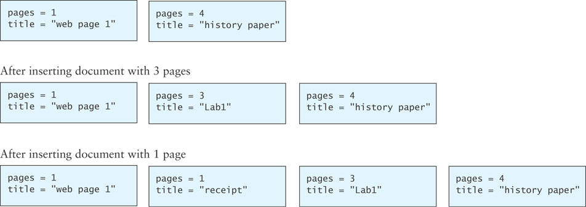
Insertion into a Priority Queue

Slide 39
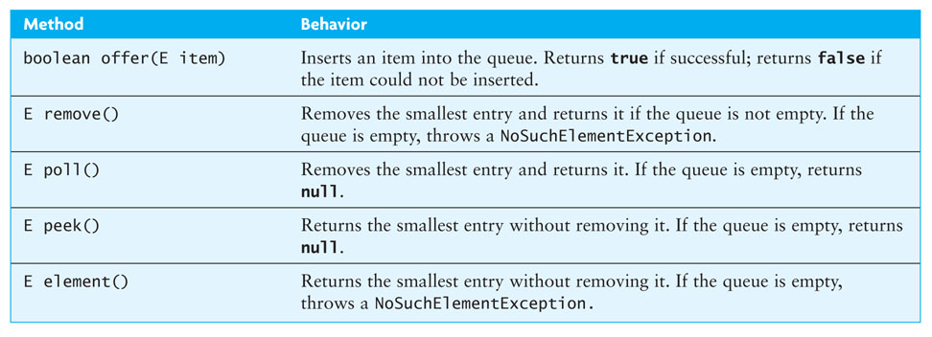
PriorityQueue Class
Java provides a PriorityQueue<E> class that implements the Queue<E> interface as follows:

Slide 40
In-Class Exercise
Let T be a min-heap storing n elements.
Give an efficient algorithm for reporting the keys that are smaller than or equal to a given integer key k:
First assuming k is in the heap
Second assuming k is not in the heap
Note: Keys do not need to be reported in sorted order
Can you make it run in O(k)?

Slide 41
Hint:
Hint: Think about where the keys smaller than k are stored in the heap T.

Slide 42
Answer
Starting at the root of the tree, recursively search the left and right subtrees if the root of the subtree has a key value less than k.
This algorithm takes O(m) time where m is the number of elements less than k, because there is no node in T storing a key larger than k that has a descendant storing a key less than x.

